Slide 1


Fake News Detection &
Verification Tool
An AI-Powered Solution for Combating Misinformation
Manikanta Peddi
Year 2026
Vellore Institute of Technology – Andhra Pradesh
Department of Software Engineering

Slide 2



Why This Project Matters
Rapid Spread of Misinformation
Social media enables fake news to spread 6x faster than truth. Threatens public trust, safety, and democracy.
70%
Manual Fact-Checking Cannot Scale
of people have encountered
misinformation online
Human verification is slow and labor-intensive. Cannot keep pace with digital content volume.
Impact Areas:
AI-Powered Solution
🗳️ Elections 🏥 Health
💼 Economy ⚖️ Safety
Automated, accurate, and real-time credibility assessment. Leverages NLP, Transformers, and Fact-Checking APIs.

Slide 3




The Challenge We're Addressing
Velocity Problem
Fake news spreads faster than verified information. Creates information cascades before correction is possible.
Impact Problem
Affects critical decisions: elections, health, public safety, economy. Real-world consequences of misinformation.
Tool Gap Problem
No unified tool to classify, verify, AND explain misinformation. Existing solutions are fragmented or incomplete.
Scale Problem
Need for automated, explainable, scalable detection system. Must handle multilingual content in real-time.

Slide 4




What We're Building
Classify News Authenticity
Real-Time Verification
Build AI tool to classify news as Real, Suspicious, or Fake. Provide confidence scores for each classification.
Enable instant claim verification using trusted APIs. Cross-reference with fact-checking databases.
Explainable AI
Multilingual & User-Friendly
Highlight suspicious phrases and patterns. Show reasoning behind classification decisions.
Support multiple languages beyond English. Intuitive interface for all user types.

Slide 5


Technology Stack
Natural Language Processing
AI Models
Text Preprocessing
Transformer Models
Tokenization, Stopword removal
Lemmatization (spaCy, NLTK)
BERT, RoBERTa, DistilBERT
Pre-trained on massive text corpora
Language Understanding
Training Approach
Named Entity Recognition (NER)
Dependency Parsing
Part-of-Speech Tagging
Fine-tuning for classification
Transfer learning optimization

Slide 6





Technology Stack
External Services
Web Technologies
Fact-Checking APIs
Backend Framework
Google Fact Check Tools API
PolitiFact API
• Flask / FastAPI
• Python-based REST APIs
Frontend
Data Storage
• HTML, CSS, JavaScript
• Responsive design
SQL Database (SQLAlchemy ORM)
Efficient schema design
Security & Deployment
• JWT Authentication
• Docker containerization

Slide 7



What This System Delivers
Automated Detection
Probability score (0-1) for fake news likelihood with real-time classification
Real-Time Verification
Instant verification of factual claims, cross-reference with trusted sources
Explainable Results
Highlighted suspicious keywords and phrases with transparent reasoning process
Source Credibility Scoring
Rate reliability of information sources with historical accuracy tracking
Multilingual Detection
Detect misinformation across languages, expand beyond English-only analysis

Slide 8


System Modules
1
User Authentication
Registration and login system
JWT-based security
Role-based access control
2
Input Processing
Text upload or URL fetch
Content extraction
Preprocessing pipeline initialization
3
Named Entity Recognition (NER)
Part-of-Speech (POS) tagging
Lemmatization and tokenization
NLP & Feature Extraction

Slide 9

System Modules
4
Classification Module
Transformer-based fake news classifier • Probability score generation • Confidence metrics
5
Claim Verification
Fact-checking API integration • Cross-reference with trusted sources • Verification result aggregation
6
Explainability & Visualization
Suspicious text highlighting • Feature importance display • Result interpretation
7
Admin Dashboard
Manage trusted sources • Monitor system usage • Analytics and reporting

Slide 10

Why These Technologies?
Why Transformers?
Why Fact-Checking APIs?
High accuracy (85-95%)
Understand contextual meaning
Proven performance in misinformation detection
Transfer learning capabilities
Real-time verification
Reliable, trusted sources (PolitiFact, Google)
Automated claim matching
Continuously updated databases
Combined Benefits
Faster than human fact-checking
Infinitely scalable
Explainable & transparent
Continuous improvement

Slide 11
Challenges & Our Approach
🎭
Sarcasm & Irony Detection
Approach: Use contextual embeddings, sentiment analysis
Challenge: Difficult for AI to understand context
📚
Domain-Specific Misinformation
Approach: Domain-specific fine-tuning, expert-validated datasets
Challenge: Medical, financial jargon requires specialized knowledge
🌍
Low-Resource Languages
Approach: Multilingual models, transfer learning
Challenge: Limited training data for many languages
⏱️
Delayed Fact-Checking Data
Approach: Credibility scoring of sources, historical patterns
Challenge: New claims take time to be verified

Slide 12
System Architecture
User Input
(Text/URL)
NLP Preprocessing
Tokenization • Lemmatization
Classification Model
BERT/RoBERTa
Claim Verification
API Integration • Source Checking
Explainability Module
Keyword Highlighting • Feature Importance
Flask Backend + Database
SQLAlchemy ORM • JWT Authentication
Dashboard Output
Results • Credibility Score • Sources

Slide 13

Data Architecture
ARTICLES TABLE
article_id (PK)
user_id (FK)
Title
Content
url
submission_date
USERS TABLE
user_id (PK)
Username
email
password_hash
created_at
ENTITIES TABLE
entity_id (PK)
processed_id (FK)
entity_text
Type
confidence_score
PROCESSED TEXT TABLE
processed_id (PK)
article_id (FK)
Tokens
lemmatized_text
entities
VERIFICATION RESULTS
result_id (PK)
article_id (FK)
prediction_label
confidence_score
fact_check_sources
timestamp

Slide 14


Future Enhancements
Social Media Integration
1
Real-time monitoring of news posts on Twitter, Facebook, Google with automated flagging system
Advanced Deep Learning
2
LSTM for sequential pattern detection • Multi-modal analysis (text + images) • Improved context understanding
Multilingual Support
3
Extend beyond English • Support for major world languages • Cross-lingual verification
Mobile Application
4
iOS and Android apps • On-the-go verification • Push notifications for trending news
Cloud-Scale Infrastructure
5
Kubernetes deployment • Load balancing • 99.9% uptime guarantee

Slide 15
System in Action
Verification Results
Input Section
PolitiFact: False
Google Fact Check: Debunked
Claim contradicts verified sources
Enter news text or paste URL...
Source Credibility
FAKE NEWS
Reliability Score: 2.1/10
Historical Accuracy: Low
Known for misinformation
Confidence: 87.5% | Risk: High
Suspicious Keywords Detected:
⚠️ Recommendation
• 'unverified claims'
• 'anonymous sources'
• 'experts say'
Do not share this content
Verified alternative sources available

Slide 16

TruthGuard - HomePage

Slide 17
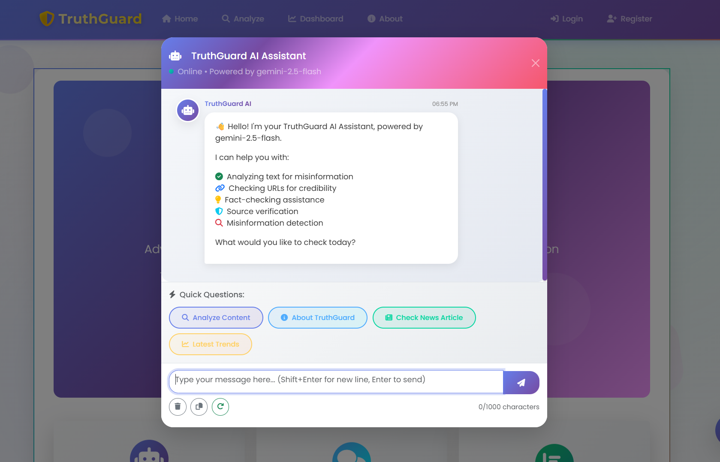
TruthGuard – TruthGuard AI Assistant

Slide 18
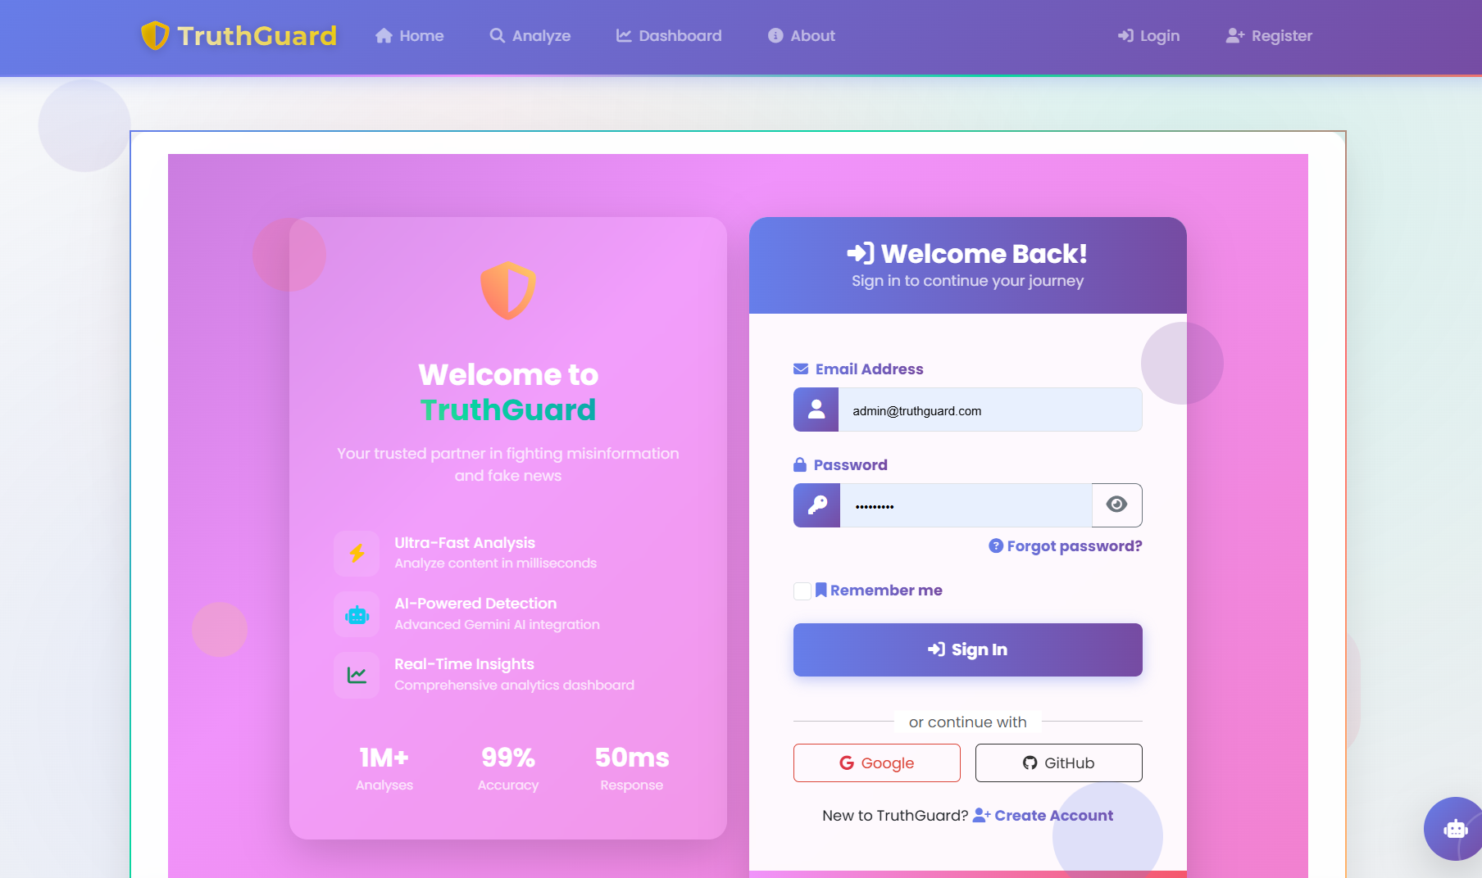
TruthGuard – Login (Admin/Users)

Slide 19

TruthGuard – User’s Dashboard

Slide 20
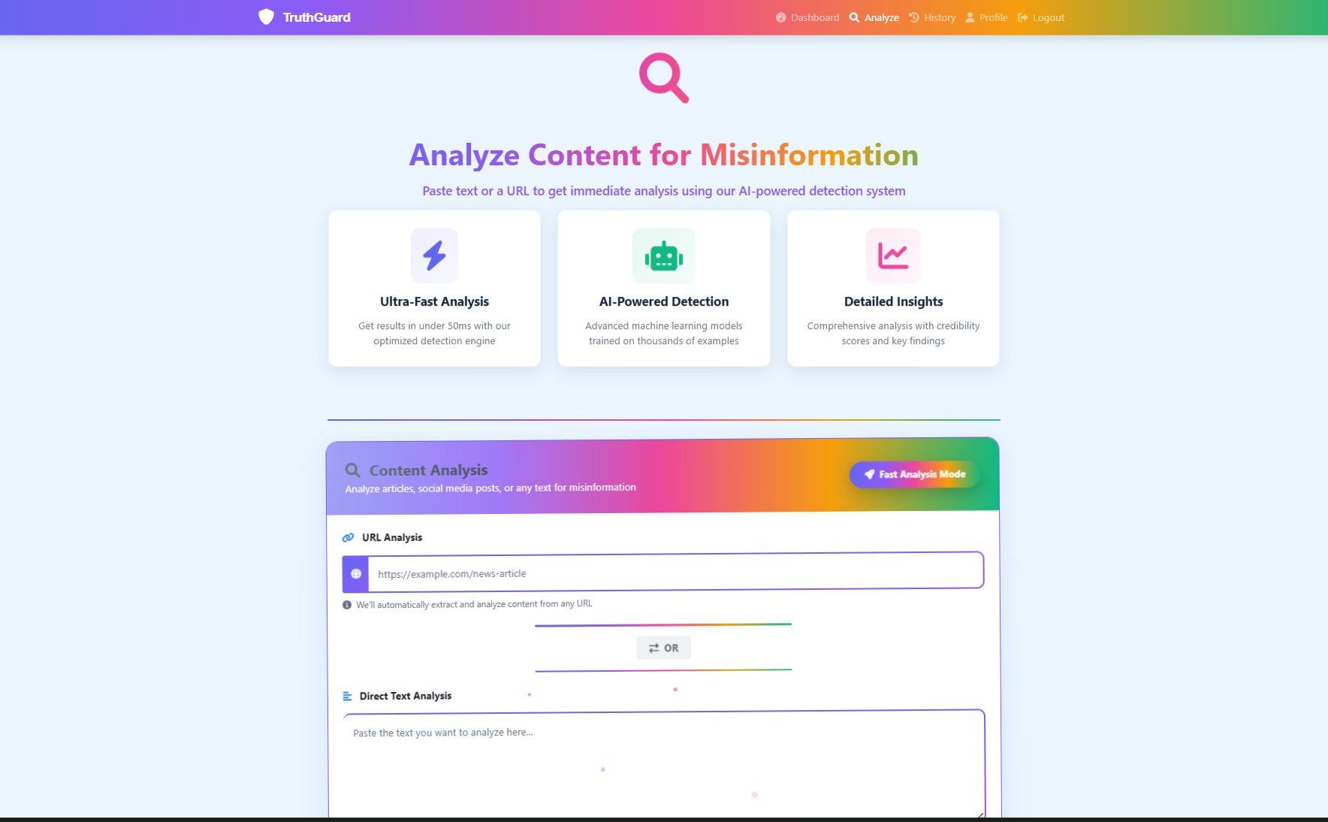
TruthGuard – Analyze

Slide 21
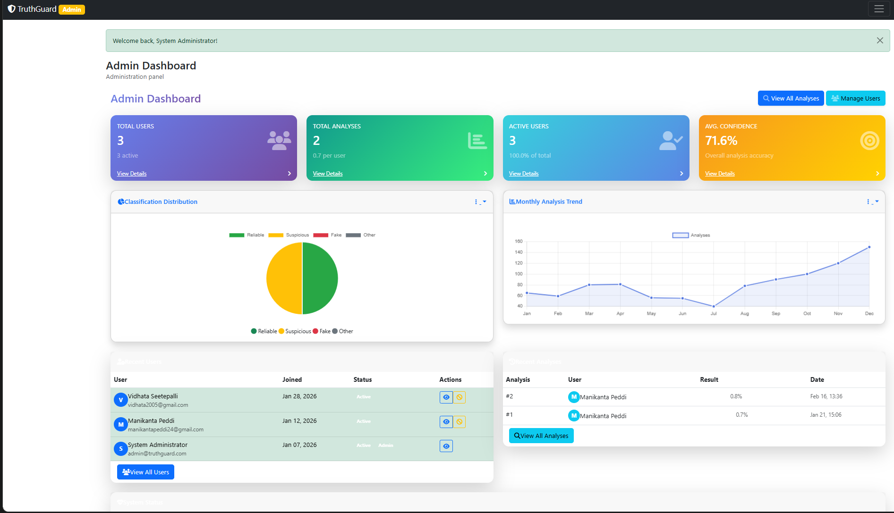
TruthGuard – Admin Dashboard

Slide 22
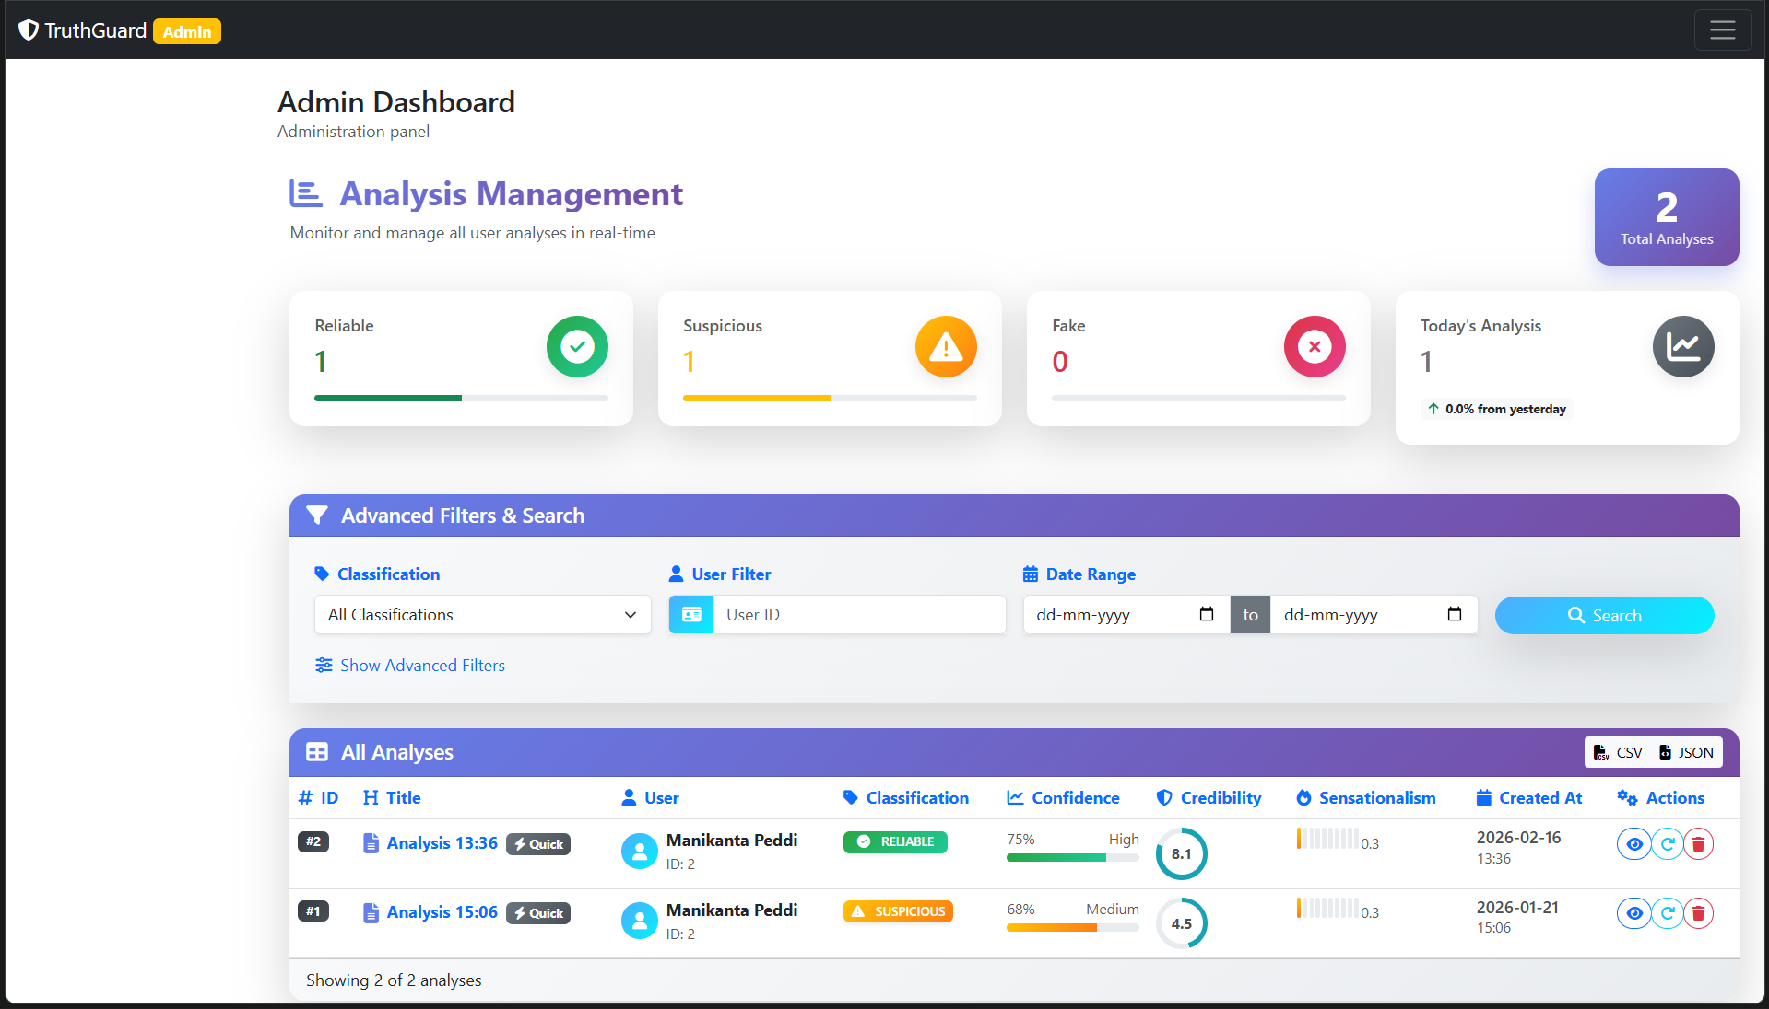
TruthGuard – Analysis Management

Slide 23
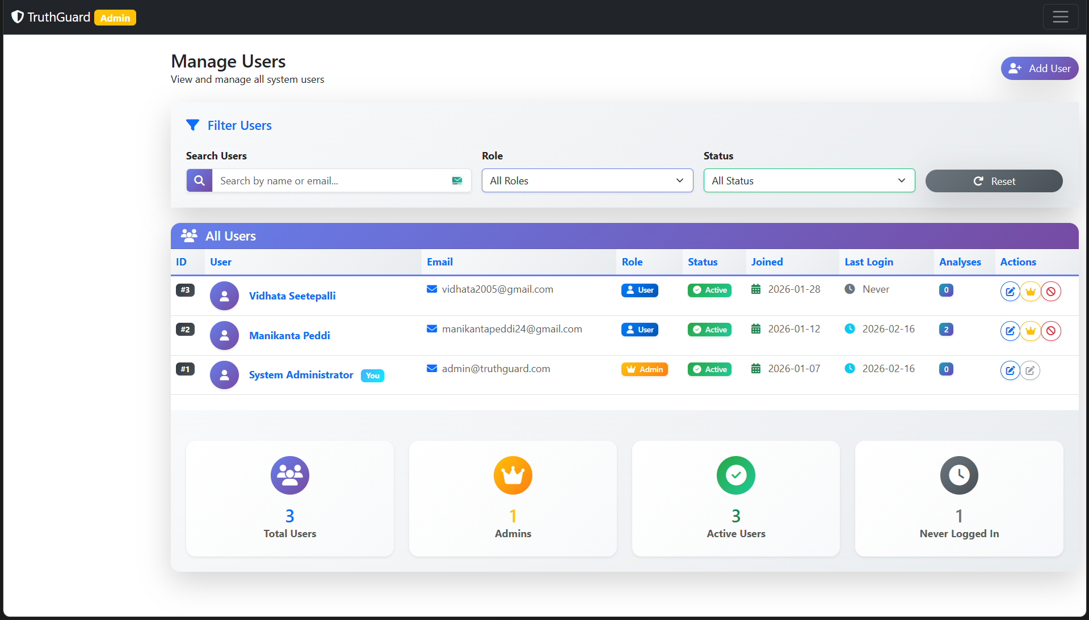
TruthGuard – User Management

Slide 24
Conclusion
Successful Integration
Combines NLP + ML + Web Tech for comprehensive misinformation detection
Accurate & Explainable
High accuracy classification (85-90%) with transparent decision-making process
Secure & Scalable
JWT authentication ready for production deployment
Real-World Impact
Builds digital trust and empowers informed decision-making
"Building a More Trustworthy Digital Future"

Slide 25

TY
Your Email: manikantapeddi24@gmail.com
GitHub: github.com/manikanta-7557
Project Repository: Go to Project Repo
Questions & Discussion

Slide 26
Thank You!
Your Email: manikantapeddi24@gmail.com
GitHub: github.com/manikanta-7557
Project Repository: Go to Project Repo
Questions & Discussion

Slide 27
Thank You!

